Slide 1
travel planner agent
CAPSTONE PROJECT
Presented By:
1. V Madhan Kumar-Cambridge Institute Of Technology-CSE

Slide 2
OUTLINE
Problem Statement
Proposed System/Solution
System Development Approach
Algorithm & Deployment
Result (Output Image)
Conclusion
Future Scope
References

Slide 3
Problem Statement
Planning a trip involves searching for destinations, transport, hotels, and weather info across different platforms, which can be time-consuming and confusing. Travelers need a smart assistant that can understand their preferences and provide personalized travel suggestions, plans, and updates in one place through a simple conversation.

Slide 4
Proposed Solution
The system takes user inputs such as:
Preferred location
Budget
Number of days
Travel interests (e.g., adventure, heritage, nature)
Based on the input, it filters suitable places using a predefined destination dataset.
It matches filtered locations with activity types based on user interests.
Real-time factors like weather, events, and map data are considered to optimize the itinerary.
An AI-based logic creates a day-wise plan including:
Place to visit
Time of visit
The final travel plan is displayed to the user in a clear and easy-to-follow format.

Slide 5
System Approach
The "System Approach" section outlines the overall strategy and methodology for developing and implementing the Smart Travel Planner system. Here's the structured approach:
IBM Cloud (mandatory)
IBM Watsonx.ai for model development and deployment
IBM Cloud Object Storage for storing datasets and input data
OpenWeatherMap API for real-time weather data integration
Google Maps API for route planning and location-based suggestions
Associated Watsonx.ai Runtime service

Slide 6
Algorithm & Deployment
r logic).
Logged into IBM Cloud and accessed the Watsonx Dashboard.
Navigated to Watsonx.ai via the documentation tab.
Entered Agentic Lab and created a sandbox project.
Selected the free plan, named the project, and initialized it.
Associated Watsonx.ai Runtime service with the project.
Opened Build an AI Agent section to start building the agent.
Added and enabled required tools for interaction.
Entered prompt instructions (e.g., welcome message, planner logic).
Created API key and deployment space for publishing.
Deployed the agent and used Preview to test final output.

Slide 7
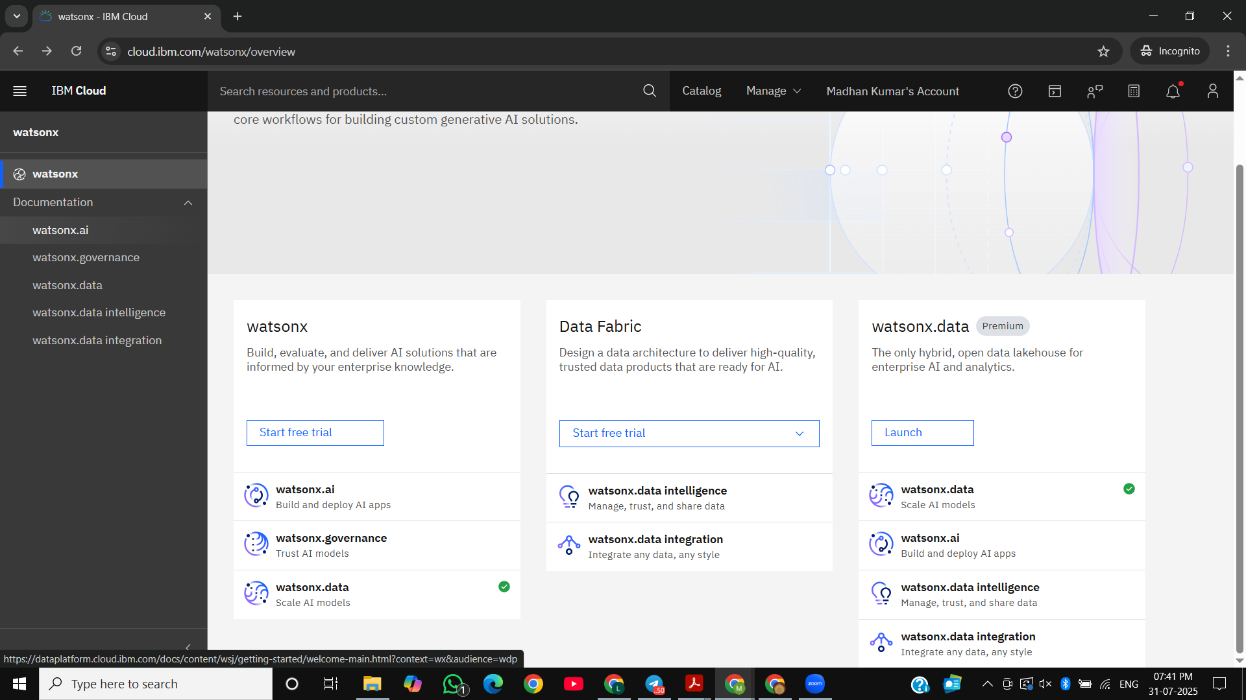
Algorithm & Deployment
r logic).

Slide 8
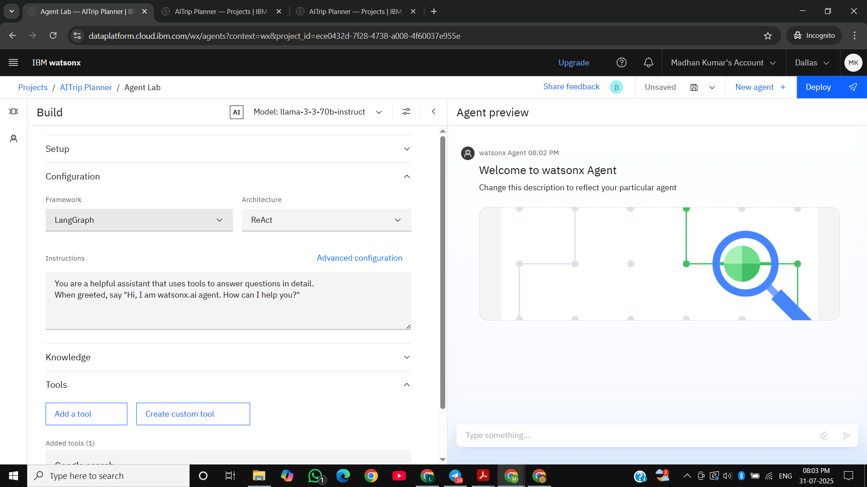
Algorithm & Deployment
r logic).

Slide 9
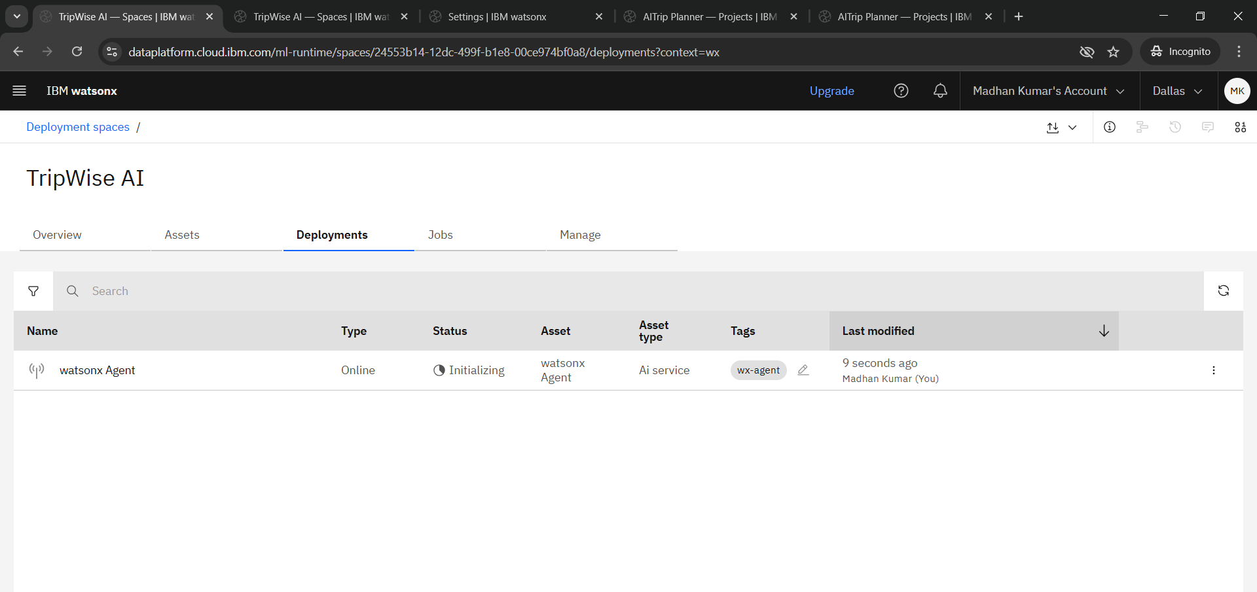
Algorithm & Deployment
r logic).

Slide 10
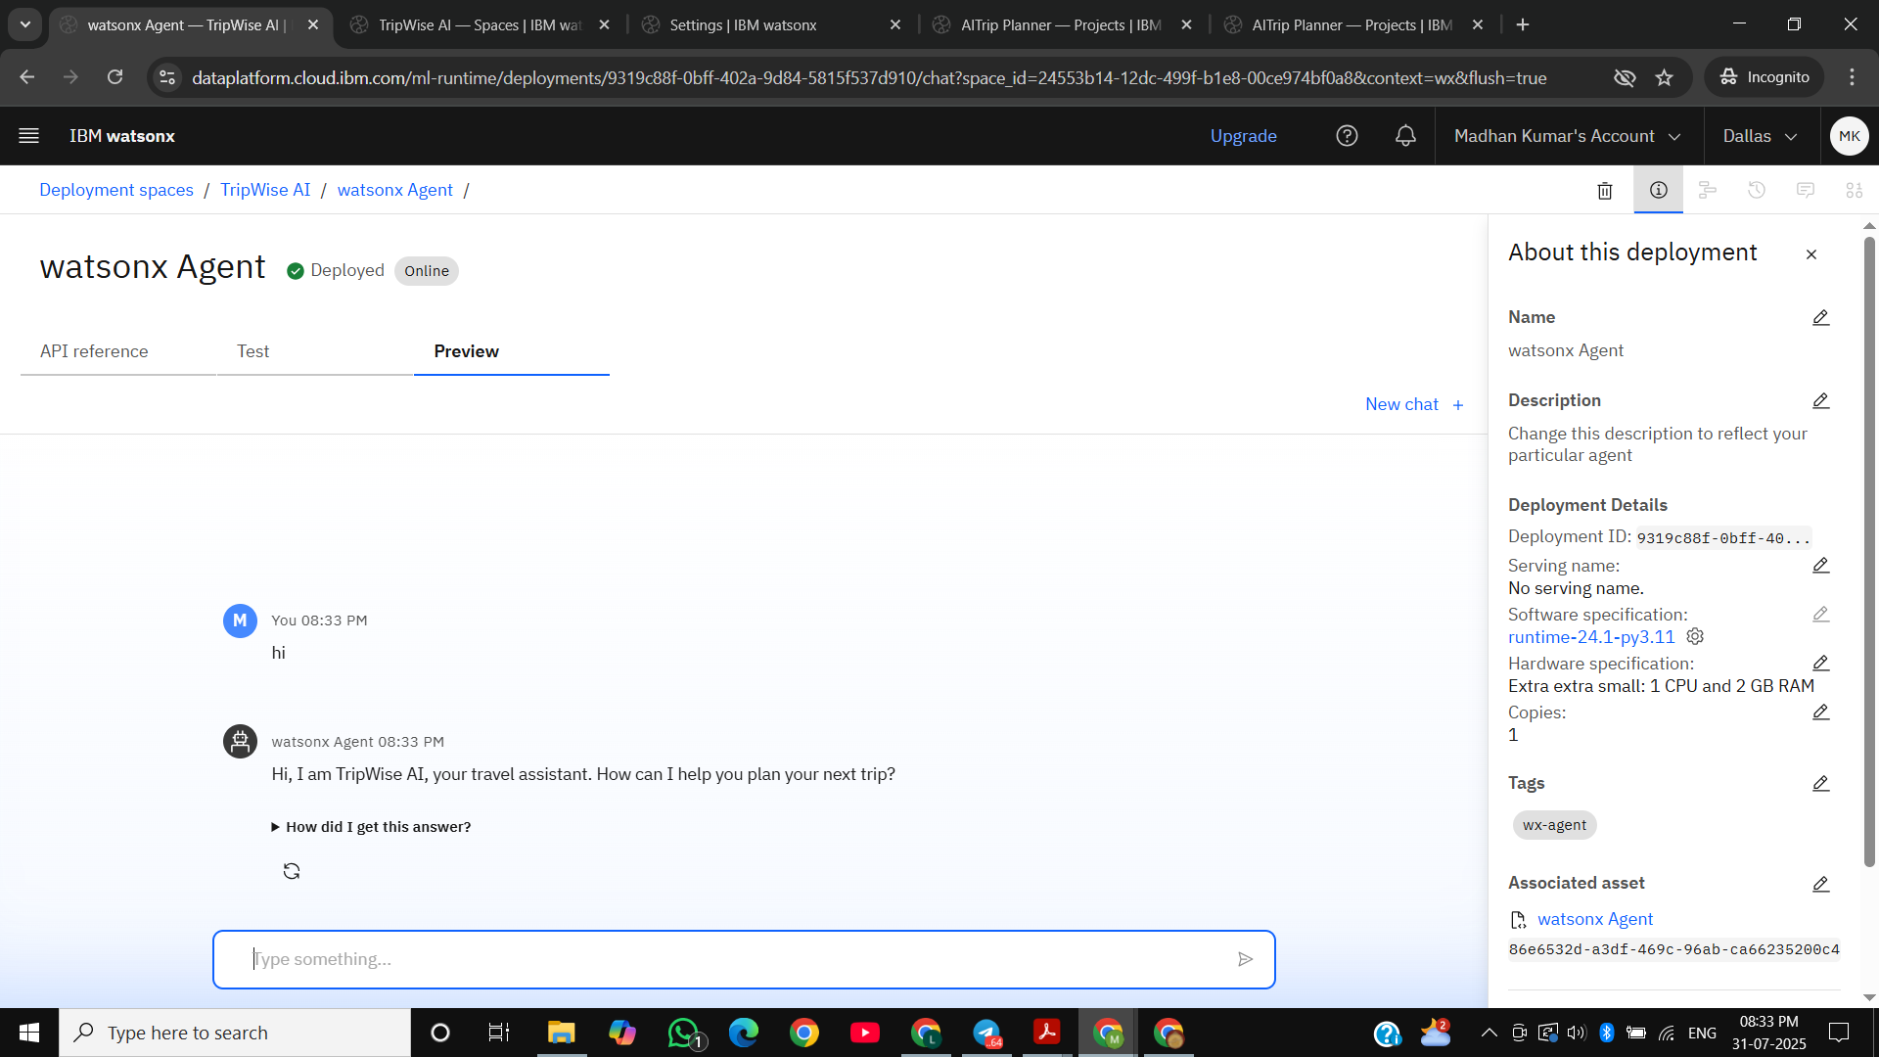
Algorithm & Deployment
r logic).

Slide 11
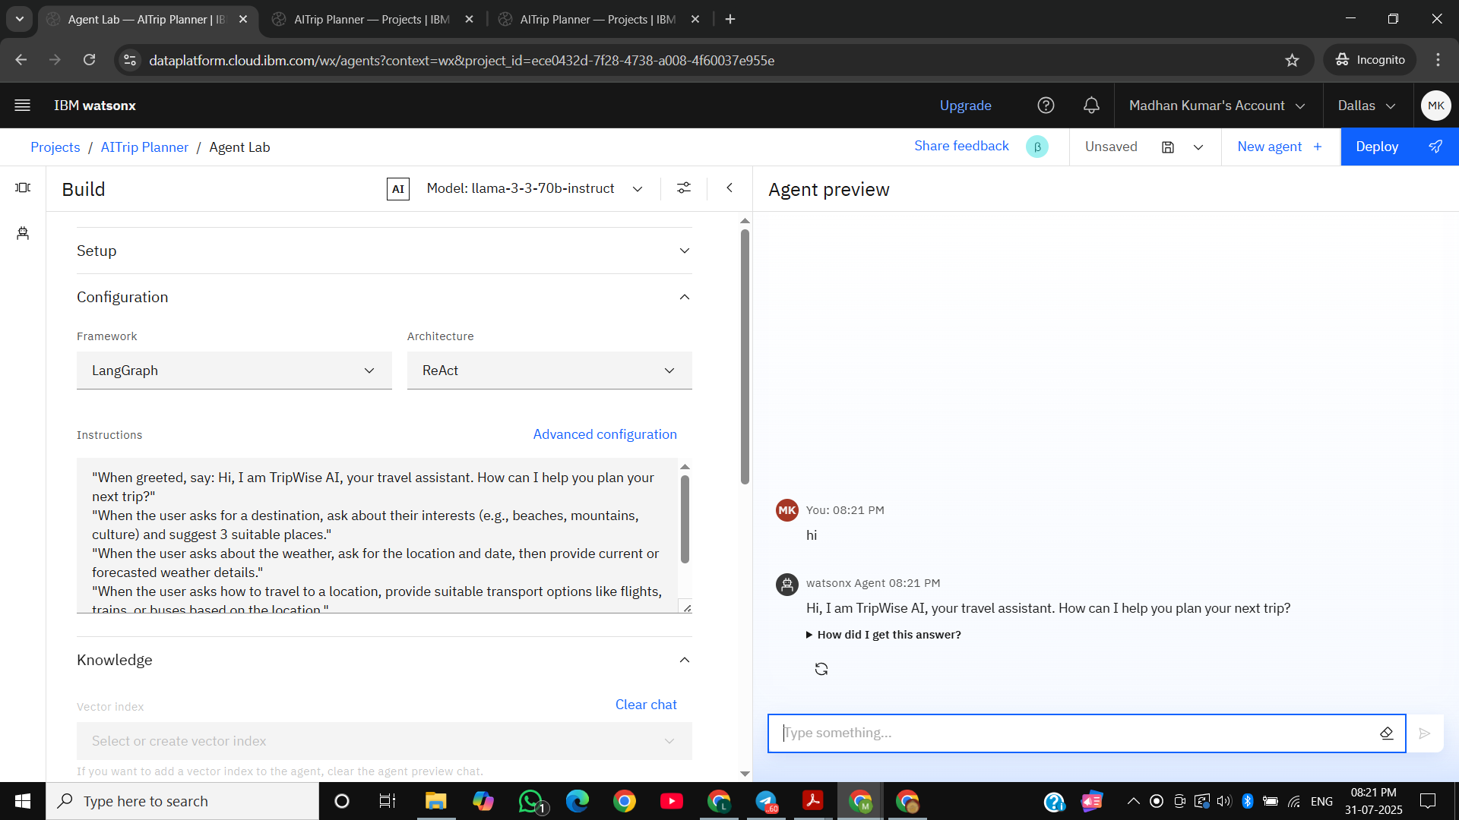
Result
Show how well the travel planner agent gives accurate and useful travel plans. Add examples of user questions and the agent’s replies to show its performance.

Slide 12
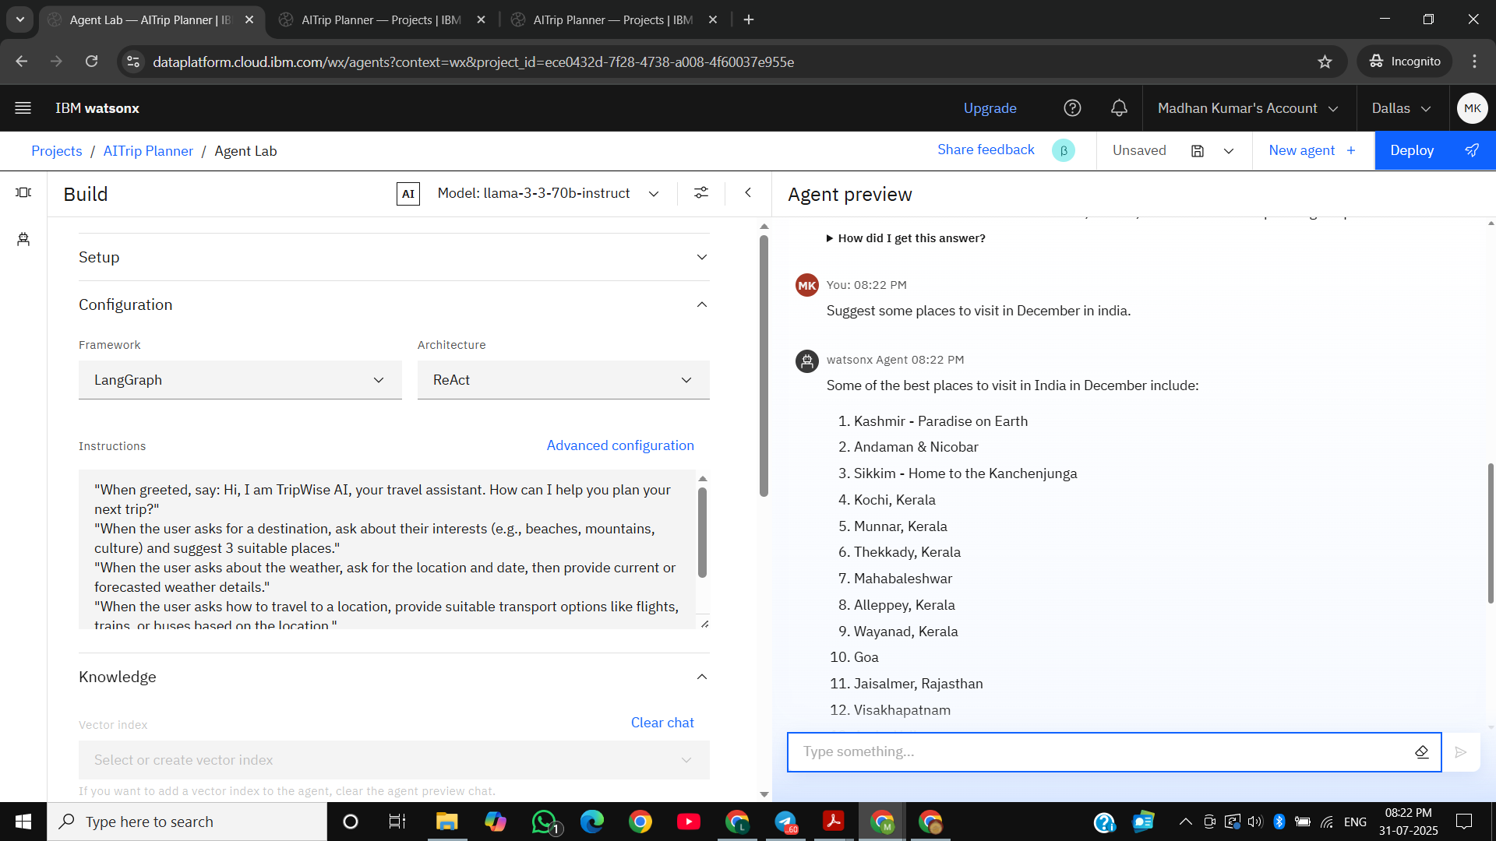
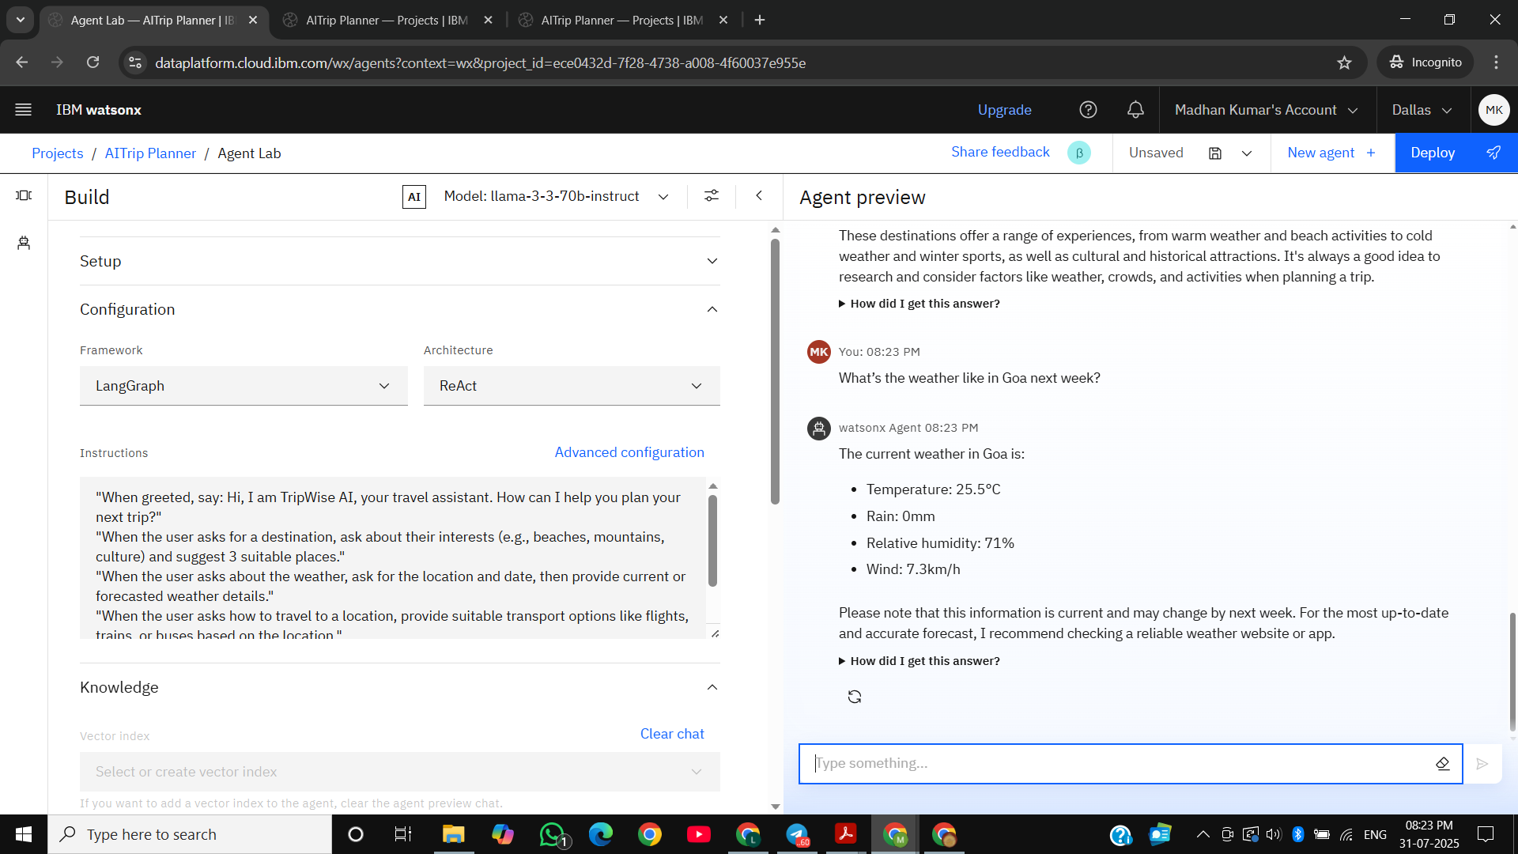
Result

Slide 13

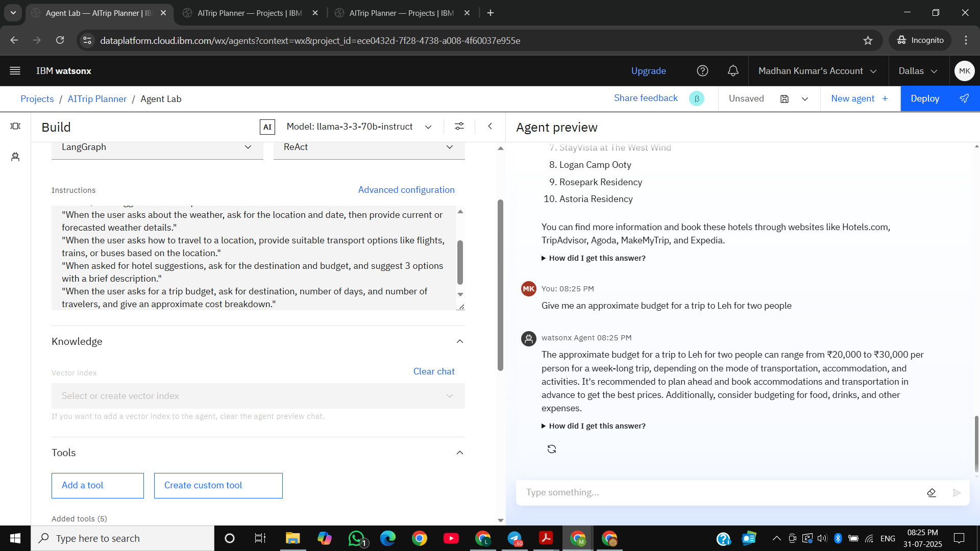
Result

Slide 14
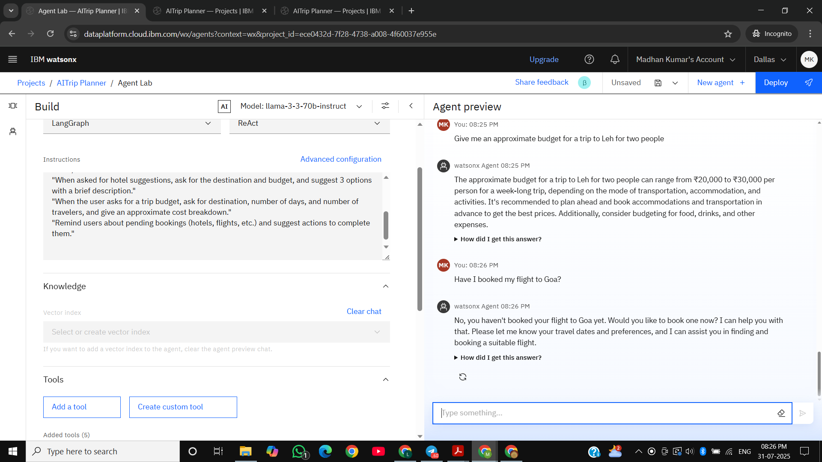
Result

Slide 15
Conclusion
Summarize the findings and discuss how effective the travel planner agent is in generating smart travel plans. Mention any challenges faced during development and suggest possible improvements. Highlight how the agent helps users plan better trips with personalized suggestions.

Slide 16
Future scope
Explore possible improvements like adding more travel data sources, making the agent faster and smarter, and expanding it to support more cities or countries.
And can also consider using advanced AI models or integrating new tech like edge computing for better performance.

Slide 17
References
List and cite relevant sources, research papers, and articles that supported the development of the travel planner agent. This may include studies on travel recommendation systems, natural language processing (NLP), AI chatbots, and best practices in AI model evaluation and deployment.

Slide 18
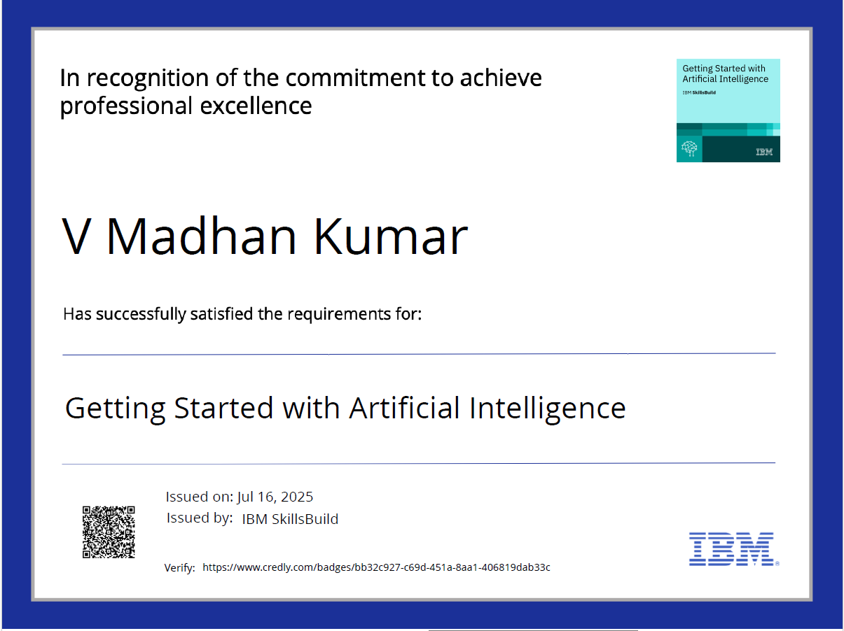
IBM Certifications

Slide 19
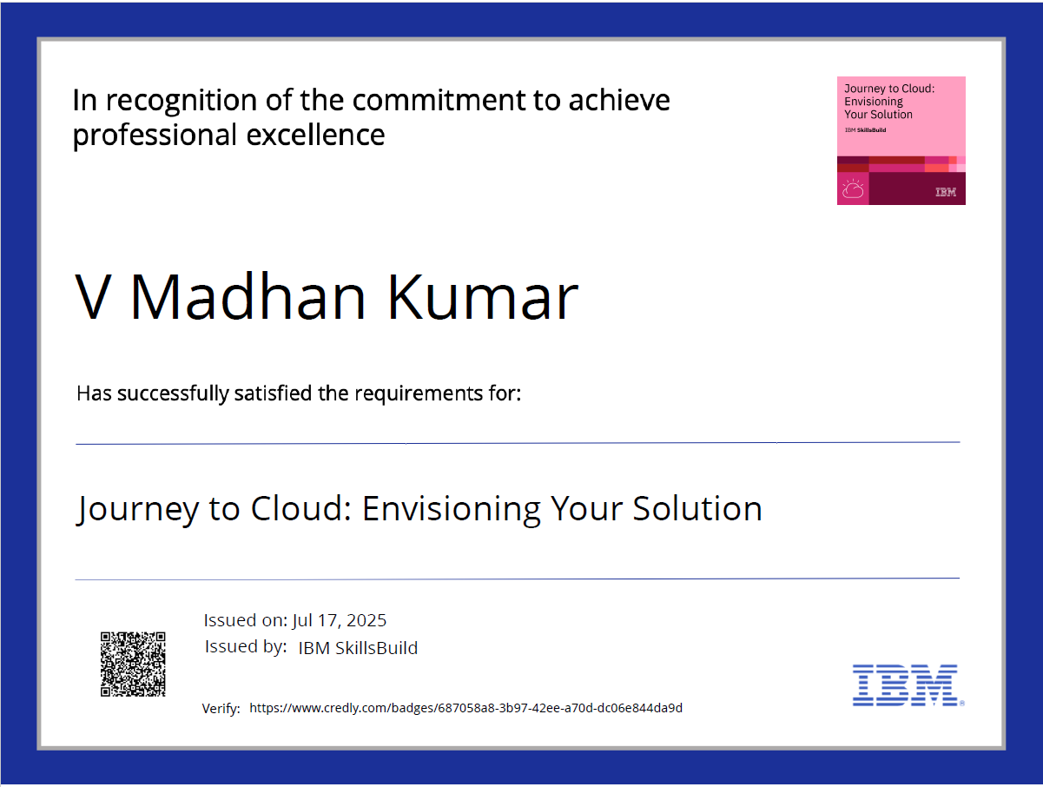
IBM Certifications

Slide 20
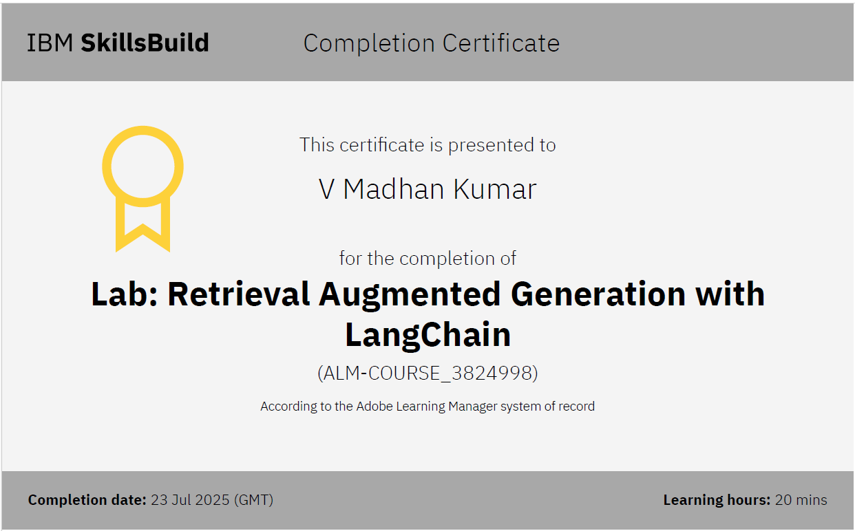
IBM Certifications

Slide 21
THANK YOU

